Slide 1
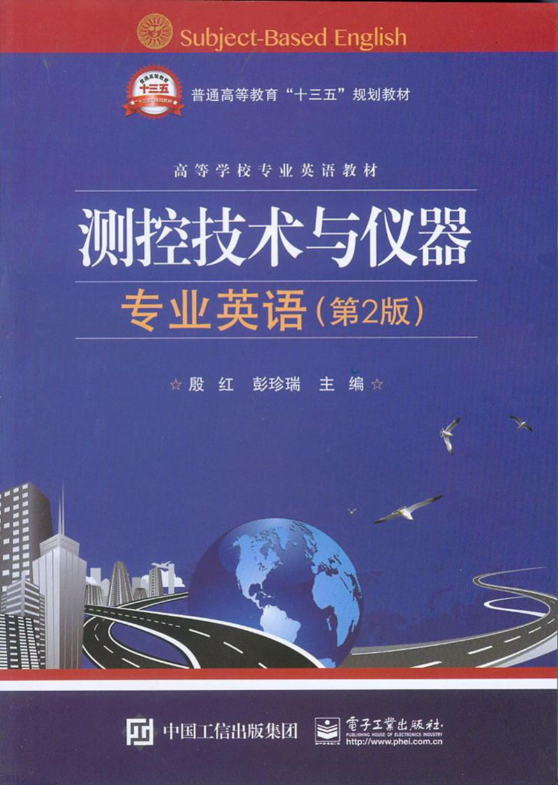
Unit8 Automatic Control

Slide 2
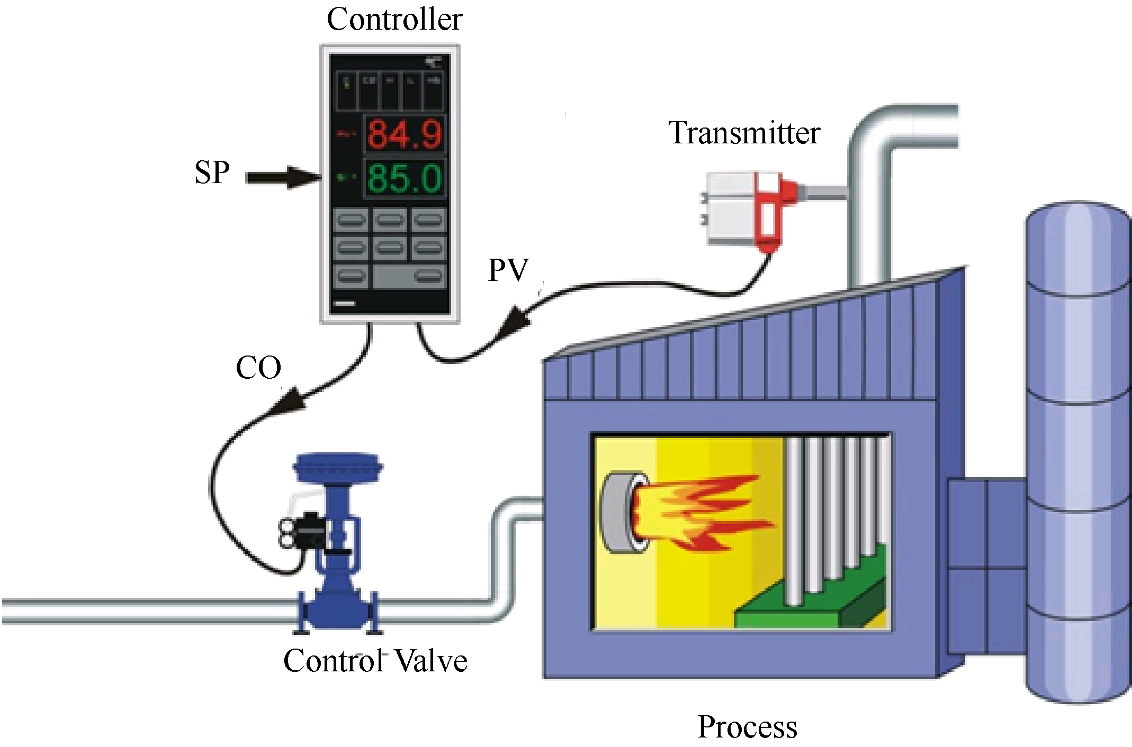
Unit8 Automatic Control

Slide 3
For example, automatic control is essential in the numerical control of machine tools in the manufacturing industries, in the design of autopilot systems in the aerospace industries, and in the design of cars and trucks in the automobile industries. It is also essential in such industrial operations as controlling pressure, temperature, humidity(湿度), viscosity(黏稠；黏性), and flow in the process industries.
句中machine tools意为“机床”。
译为：比如，在制造业中机床的数控，在航天工业中自动导航系统的设计，在汽车工业中客货车的设计，自动控制都起着重要的作用。

Slide 4
Since advances in the theory and practice of automatic control provide the means for attaining optimal performance of dynamic systems, improving productivity, relieving the drudgery(苦差事，苦差，苦工)of many routine repetitive manual operations, and more, most engineers and scientists must now have a good understanding of this field.
译为：因为自动控制理论与实践的发展，提供了很多方法，来获得最优的动态系统特性、提高生产率、降低很多例行重复性人工劳动的强度，现在，许多，甚至大多的工程师和科学家必须对这个领域有一个很好的理解。

Slide 5
Control theory
There are two major divisions in control theory, namely, classical and modern, which have direct implications over the control engineering applications. The scope of classical control theory is limited to single-input and single-output (SISO) system design.
控制理论有两大分支，即，经典控制理论和现代控制理论。这种分类直接体现在控制工程的不同应用中。经典控制理论的应用范围局限于单输入单输出(SISO)的系统设计。

Slide 6
The system analysis is carried out in time domain using differential equations, in complex-s domain with Laplace transform or in frequency domain by transforming from the complex-s domain. All systems are assumed to be second order and single variable, and higher-order system responses and multivariable effects are ignored.
系统用微分方程实现时域分析，用拉普拉斯变换实现复数（s）域分析，或将复数域转换到频域分析。所有系统都假定为二阶单变量系统，高阶系统响应和多变量影响忽略不计。

Slide 7
A control system is an interconnection of components forming a system configuration that will provide a desired system response. The basis for analysis of a system is the foundation provided by linear system theory, which assumes a cause-effect relationship for the components of a system.
句中cause-effect relationship意为“因果关系”。
控制系统是元件间相互连接，形成一个系统结构，提供期望的系统响应。系统分析的基础是基于线性系统理论，线性系统理论假定了系统组件的因果关系。

Slide 8
Control System
In general, control systems can be categorized as being either open-loop or closed-loop. The distinguishing feature between these two types of control systems is the use of feedback comparison for closed-loop operation.
一般地，控制系统分为开环系统和闭环系统。这两种控制系统的特性区别是闭环操作使用了反馈比较器。

Slide 9
1．Open-loop Control System开环控制系统
An open-loop control system utilizes a controller or control actuator to obtain the desired response, as shown in Figure 8.2. An open-loop system is a system without feedback. simplest form of controlling devices. Figure 8.3 illustrates a simple tank-level control system (液位控制系统 ).
开环控制系统利用控制器或控制执行器获得期望响应。如图8.2所示。开环系统是无反馈的系统，是最简单的控制形式。图8.3表述了一个简单的液位控制系统。

Slide 10
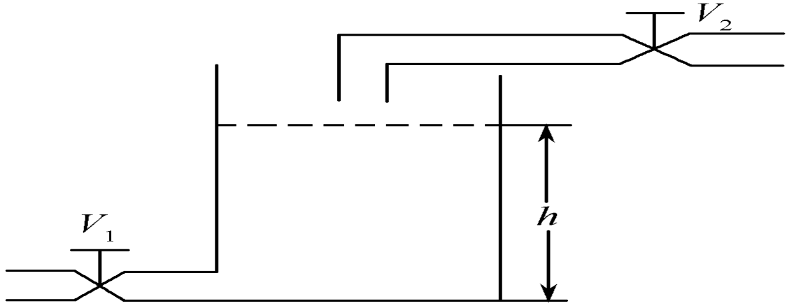
The system is not a precision system，as it does not have the capability of accurately measuring the output flow rate through valve V1 ，the input flow rate through valve V2 ，or the tank level.
译为：这种系统不是一个精确的系统，因为它没有能力精确测量阀V1的输出流量、阀V2的输入流量或液面高度。
Figure 8.3 Tank-level control system

Slide 11
Figure 8.4 shows the simple relationship that exists in this system between the input (the desired tank level) (期望液面高度)and the output (the actual tank level)(实际液面高度). This control system does not have any feedback comparison，and the term open loop is used to describe this absence.
图8.4表示系统输入（期望液面高度）和输出（实际液面高度）间最简单的关系。这个控制系统没有任何反馈比较，术语开环即表明不存在反馈。

Slide 12
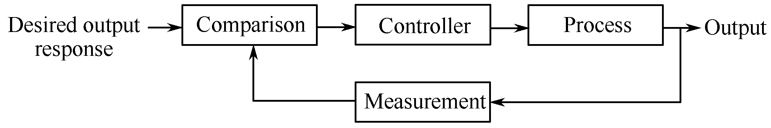
2．Closed-loop Control System闭环控制系统
A feedback control system is a control system that tends to maintain a prescribed relationship of one system variable to another by comparing functions of these variables and using the difference as a means of control.
译为：反馈控制系统往往通过变量的比较并利用偏差作为控制手段，维持一个系统变量对另一个系统变量的指定关系。
Figure 8.5 Closed-loop control system

Slide 13
Closed-loop control systems derive their valuable accurate reproduction of the input from feedback comparison. An error detector derives a signal proportional to the differences between the input and output．The closed-loop control system drives the output until it equals the input and the error is zero．
句中derive from意为“源于……”。
译为：闭环控制系统的反馈比较器使得输入变量精确再现。误差检测器得到一个正比于输入输出偏差的信号。闭环控制系统直到输出达到输入，误差为零时，才获得输出值。

Slide 14
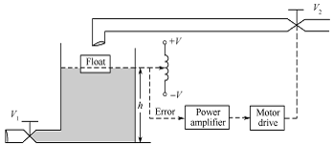
It can maintain the desired tank level h within quite accurate tolerances even through the output flow rate through value V1 is varied.
译为：即便阀V1的输出流量是可变的，也可将输出量保持在期望液面高度h的一个非常精确的公差范围之内。
Figure 8.6 Automatic tank-level control system

Slide 15
Due to the increasing complexity of the system under control and the interest in achieving optimum performance, the importance of control system engineering has grown in the past decade. Furthermore, as the system become more complex, the interrelationship（相互关系）of many controlled variables must be considered in the control scheme. A block diagram depicting（描绘，描述）a multivariable control system is shown in Figure 8.8.
由于受控系统日趋复杂及对实现最优性能的兴趣，控制系统工程的重要性在过去十年间日渐增加。而且，因为系统变得越来越复杂，许多被控量之间的相互关系必须要在控制模式中考虑好。表述多变量控制系统的方框图如图8.8所示。

Slide 16
The introduction of feedback enables us to control a desired output and can improve accuracy, but it requires attention to the issue of stability of response.
反馈的引入能使我们控制期望输出，能提高准确性。但要求注意相应稳定性问题。

